Slide 1
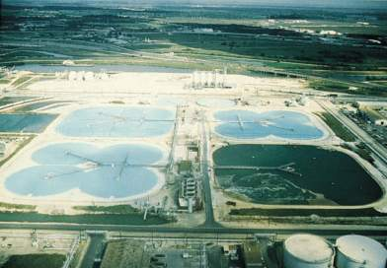
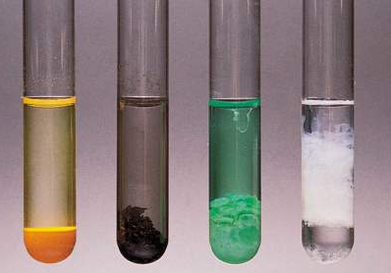
Reactions in Aqueous Solution
Chapter 4
Solution Stoich, Acid/Base theory, and Solution terms will be covered later!!!

Slide 2
Quick Review of Reactions from Chemistry I
Synthesis
Decomposition (carbonates, chlorates)
Single Replacement
Double Replacement
Combustion

Slide 3
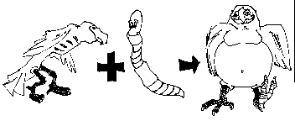
1. Synthesis reactions
Synthesis reactions occur when two substances (generally elements) combine and form a compound. (Sometimes these are called combination or addition reactions.)
reactant + reactant → 1 product
Basically: A + B → AB
  Example: 2H₂ + O₂ → 2H₂O
  Example: C + O₂ → CO₂

Slide 4
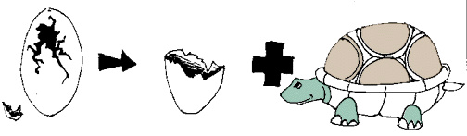
2. Decomposition Reactions
Decomposition reactions occur when a compound breaks up into the elements or in a few to simpler compounds
1 Reactant → Product + Product
In general: AB → A + B
Example: 2 H₂O → 2H₂ + O₂
Example: 2 HgO → 2Hg + O₂

Slide 5
Decomposition Exceptions
Carbonates and chlorates are special case decomposition reactions that do not go to the elements.
  Carbonates (CO₃²⁻) decompose to carbon dioxide and a metal oxide
    Example: CaCO₃ → CO₂ + CaO
  Chlorates (ClO₃⁻) decompose to oxygen gas and a metal chloride
    Example: 2 Al(ClO₃)₃ → 2 AlCl₃ + 9 O₂
  There are more exceptions!!!!!! (see handout)

Slide 6
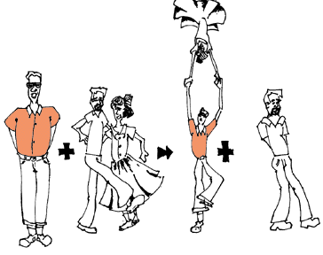
3. Single Replacement Reactions
Single Replacement Reactions occur when one element replaces another in a compound.
A metal can replace a metal (+) OR
a nonmetal can replace a nonmetal (-).
element + compound→ product + product
  A + BC → AC + B (if A is a metal) OR
  A + BC → BA + C (if A is a nonmetal)
(remember the cation always goes first!)
When H₂O splits into ions, it splits into
H⁺ and OH⁻ (not H+ and O⁻² !!)

Slide 7
Activity Series of Metals
See handout!
lithium
potassium
strontium
calcium
sodium
-------------------------------
magnesium
aluminum
zinc
Chromium
--------------------------------
iron
cadmium
cobalt
nickel
tin
Lead
--------------------------------
HYDROGEN
antimony
arsenic
bismuth
Copper
--------------------------------
mercury
silver
palladium
Platinum
gold
Each element on the list replaces from a compound any of the elements below it. The larger the interval between elements, the more vigorous the reaction.
The first five elements (lithium - sodium) are known as very active metals and they react with cold water to produce the hydroxide and hydrogen gas.
The next four metals (magnesium - chromium) are considered active metals and they will react with very hot water or steam to form the oxide and hydrogen gas.
The oxides of all of these first metals resist reduction by H₂.
The next six metals (iron - lead) replace hydrogen from HCl and dil. sulfuric and nitric acids. Their oxides undergo reduction by heating with H₂, carbon, and carbon monoxide.
The metals lithium - copper, can combine directly with oxygen to form the oxide.
The last five metals (mercury - gold) are often found free in nature, their oxides decompose with mild heating, and they form oxides only indirectly.

Slide 8
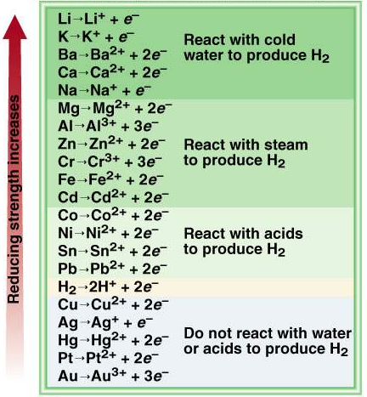
The Activity Series for Metals
Hydrogen Displacement Reaction
M + BC MC + B
M is metal
BC is acid or H₂O
B is H₂
Ca + 2H₂O Ca(OH)₂ + H₂
Pb + 2H₂O Pb(OH)₂ + H₂
Figure 4.15
4.4

Slide 9
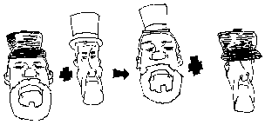
4. Double Replacement Reactions
Double Replacement Reactions occur when a metal replaces a metal in a compound and a nonmetal replaces a nonmetal in a compound
Compound + compound → product + product
AB + CD → AD + CB

Slide 10
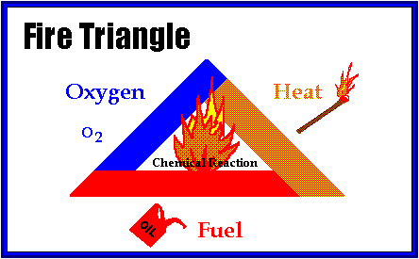
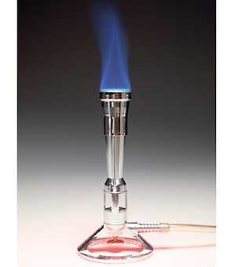
5. Combustion Reactions
Combustion reactions occur when a hydrocarbon reacts with oxygen gas.
This is also called burning!!! In order to burn something you need the 3 things in the “fire triangle”:
1) A Fuel (hydrocarbon)
2) Oxygen to burn it with
3) Something to ignite the reaction (spark)

Slide 11
Learning Check
Write MOLECULAR reaction equations for each of the following:
Solid lithium reacts with calcium chloride
Aluminum oxide reacts with water
Sodium carbonate is heated
Barium hydroxide reacts with sulfuric acid
Chlorobenzene (C₆H₅Cl) is burned in air
Notes:
2 Li + CaCl2 → 2 LiCl + Ca
Al2O3 + 3H2O → 2Al(OH)3
Na2CO3 → CO2 + Na2O
Ba(OH)2 + H2SO4 → BaSO4 + 2H2O
4C6H5Cl + 29O2 → 24CO2 + 10H2O + 2Cl2

Slide 12
Ionization of acetic acid
CH₃COOH CH₃COO⁻ (aq) + H⁺ (aq)
A reversible reaction. The reaction can occur in both directions.
Acetic acid is a weak electrolyte because its ionization in water is incomplete.
4.1

Slide 13
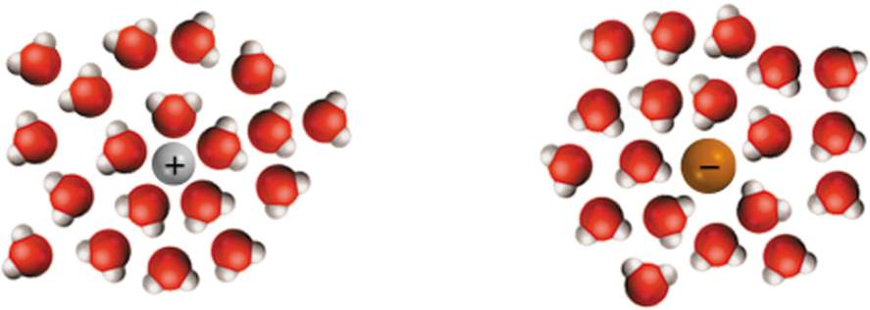
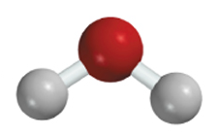
Hydration is the process in which an ion is surrounded by water molecules arranged in a specific manner.
δ⁻
δ⁺
H₂O
4.1

Slide 14
Conduct electricity in solution?
Cations (+) and Anions (-)
Strong Electrolyte – 100% dissociation
H₂O
NaCl (s) Na⁺ (aq) + Cl⁻ (aq)
Weak Electrolyte – not completely dissociated
CH₃COOH CH₃COO⁻ (aq) + H⁺ (aq)
4.1

Slide 15
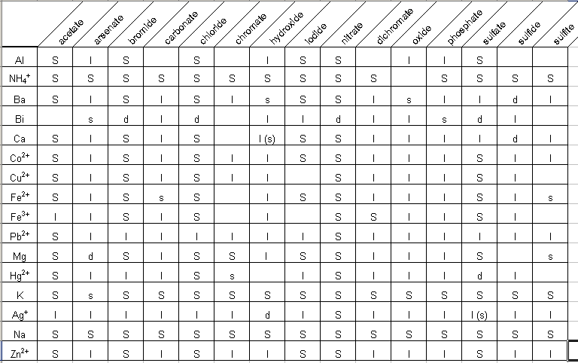
Solubility Table from last year
(say goodbye!!)

Slide 16
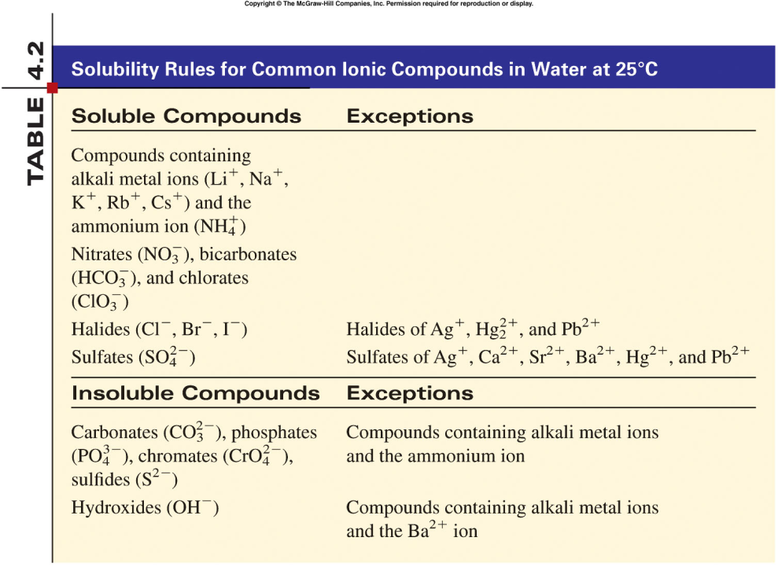
Pb⁺² will dissolve in HOT water
Memorize
for AP
Should be Hg₂²⁺
4.2

Slide 17
Other Solubilities
(Memorize for AP)
Gases only slightly dissolve in water
Strong acids and bases dissolve in water (see handout)
  Hydrochloric, Hydrobromic, Hydroiodic, Nitric, Sulfuric, Perchloric Acids
  Group I hydroxides (in the rules already!)
Water slightly dissolves in water! (H⁺ and OH⁻)

Slide 18
New AP format (2013)
There is NO longer a separate free response question just for reactions!
Reactions will be one part of a larger question
Reactions should still be balanced, net ionic equations
Example:
A student performs an experiment in which Ca(OH)₂ is reacted with 0.20 M H₂SO₄. The original volume of the Ca(OH)₂ solution is 50.0 mL. A precipitate of CaSO₄ is formed during the titration.
(a) As the first 30.0 mL of 0.10 M H₂SO₄ are added to the Ca(OH)₂ solution, two types of chemical reactions occur simultaneously. On the lines provided below, write the balanced net-ionic equations for (i) the neutralization reaction and (ii) the precipitation reaction.

Slide 19
Total Ionic Equations
Once you write the molecular equation (synthesis, decomposition, etc.), you should check for reactants and products that are soluble or insoluble.
We usually assume the reaction is in water
We can use solubility rules to tell us which compounds dissolve in water.
If the compound is soluble (does dissolve in water), then splits the compound into its component ions
If the compound is insoluble (does NOT dissolve in water), then it remains as a compound

Slide 20
Total Ionic Equations
Molecular Equation:
K₂CrO₄ + Pb(NO₃)₂ → PbCrO₄ + 2 KNO₃
Soluble Soluble Insoluble Soluble
Total Ionic Equation:
2 K⁺ + CrO₄ ⁻² + Pb⁺² + 2 NO₃⁻ →
PbCrO₄ (s) + 2 K⁺ + 2 NO₃⁻

Slide 21
Writing Net Ionic Equations
Write the balanced molecular equation.
Write the ionic equation showing the strong electrolytes completely dissociated into cations and anions.
Cancel the spectator ions on both sides of the ionic equation
AP always expects a balanced net ionic equation!
Write the net ionic equation for the reaction of silver
nitrate with sodium chloride. A ppt is formed.
AgNO₃ (aq) + NaCl (aq) AgCl (s) + NaNO₃ (aq)
Ag⁺ + NO₃⁻ + Na⁺ + Cl⁻ AgCl (s) + Na⁺ + NO₃⁻
Ag⁺ + Cl⁻ AgCl (s)
4.2

Slide 22
Net Ionic Equations
Try this one! Write the molecular, total ionic, and net ionic equations for this reaction: Silver nitrate reacts with Lead (II) Chloride in hot water. A precipitate is formed.
  AgNO₃ + PbCl₂ →
  Molecular:
  2 AgNO₃ + PbCl₂ → 2 AgCl + Pb(NO₃)₂
  Total Ionic:
  2 Ag⁺ + 2 NO₃⁻ + Pb⁺² + 2 Cl⁻ → 2 AgCl (s) + Pb⁺² + 2 NO₃⁻
  Net Ionic:
  Ag⁺ + Cl⁻ → AgCl (s)

Slide 23
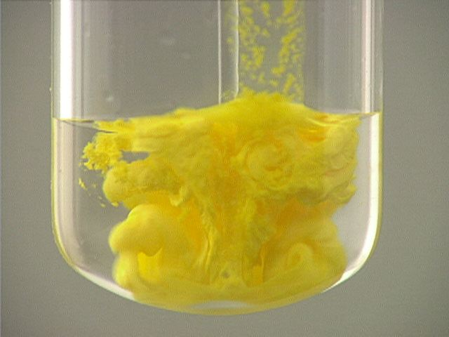
Precipitation Reactions
Precipitate – insoluble solid that separates from solution
precipitate
Pb(NO₃)₂ (aq) + 2NaI (aq) PbI₂ (s) + 2NaNO₃ (aq)
molecular equation
Pb²⁺ + 2NO₃⁻ + 2Na⁺ + 2I⁻ PbI₂ (s) + 2Na⁺ + 2NO₃⁻
ionic equation
“If you’re not a part of the solution, then you’re a part of the precipitate!”
Pb²⁺ + 2I⁻ PbI₂ (s)
net ionic equation
Na⁺ and NO₃⁻ are spectator ions
4.2

Slide 24
Gas Producing Decompositions
  These PRODUCTS will further decompose!
  Carbonic acid (breaks up into CO₂ and water)
  Ammonium hydroxide (breaks up into NH₃ and water)
  Sulfurous acid (breaks up into SO₂ and water)
  – see I.C.11 on handout

Slide 25

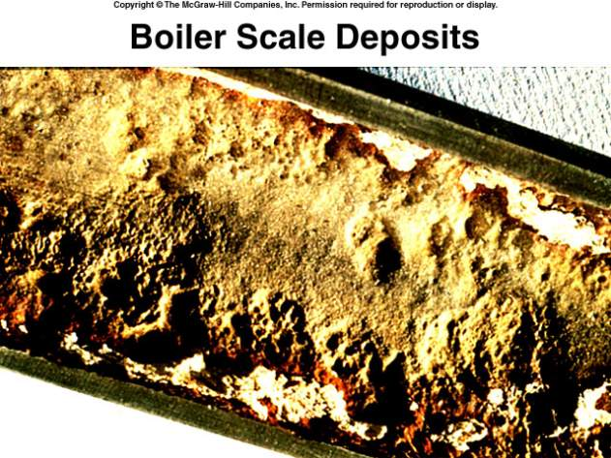
Chemistry In Action:
An Undesirable Precipitation Reaction
-
Ca²⁺ (aq) + 2HCO₃ (aq) CaCO₃ (s) + CO₂ (aq) + H₂O (l)
CO₂ (aq) CO₂ (g)
4.2

Slide 26
Terminology for Redox Reactions
OXIDATION—loss of electron(s) by a species; increase in oxidation number; increase in oxygen.
REDUCTION—gain of electron(s); decrease in oxidation number; decrease in oxygen; increase in hydrogen.
OXIDIZING AGENT—electron acceptor; species is reduced. *^{no longer on AP Exam}
REDUCING AGENT—electron donor; species is oxidized. ^{*no longer on AP Exam}
When you go to a travel agent,
who ends up traveling? YOU, or the agent?

Slide 27
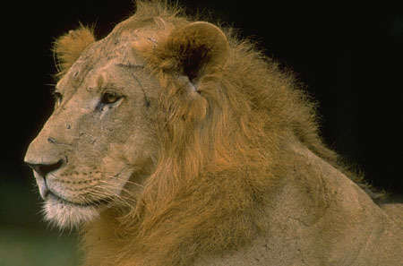
You can’t have one… without the other!
Reduction (gaining electrons) can’t happen without an oxidation to provide the electrons.
You can’t have 2 oxidations or 2 reductions in the same equation. Reduction has to occur at the cost of oxidation
LEO the lion says GER!
ose
lectrons
xidation
ain
lectrons
eduction
GER!

Slide 28
Another way to remember
OIL RIG
xidation
s
eduction
s
ain
ose

Slide 29
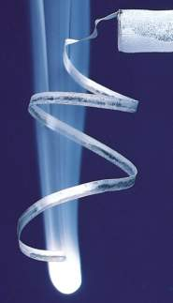
Oxidation-Reduction Reactions
(electron transfer reactions)
2Mg (s) + O₂ (g) 2MgO (s)
2Mg 2Mg²⁺ + 4e⁻
Oxidation half-reaction (lose e⁻)
O₂ + 4e⁻ 2O²⁻
Reduction half-reaction (gain e⁻)
2Mg + O₂ + 4e⁻ 2Mg²⁺ + 2O²⁻ + 4e⁻
2Mg + O₂ 2MgO
4.4

Slide 30
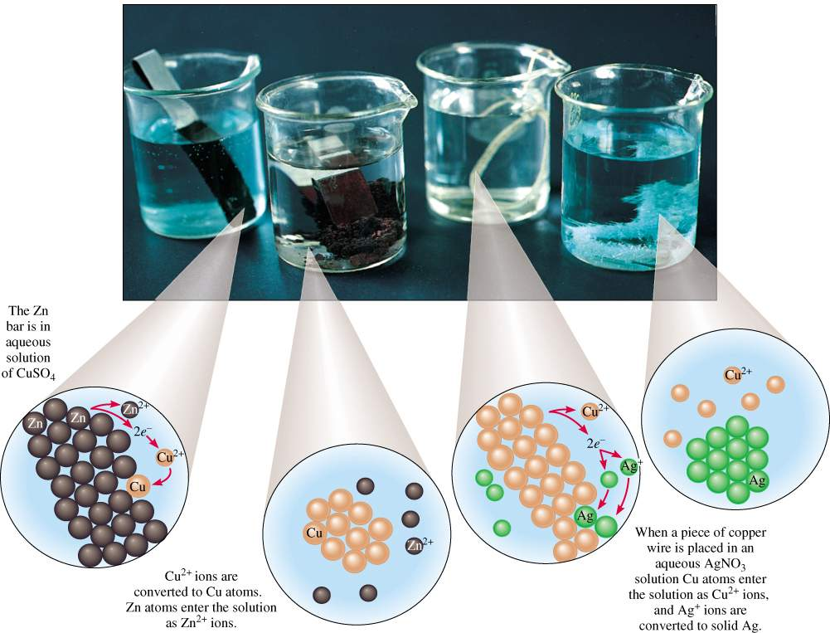
4.4

Slide 31
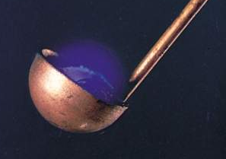
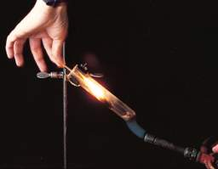
Types of Oxidation-Reduction Reactions
Combination Reaction
A + B C
0
0
+4
-2
S + O₂ SO₂
Decomposition Reaction
C A + B
+1
+5
-2
+1
-1
0
2KClO₃ 2KCl + 3O₂
4.4

Slide 32
Types of Oxidation-Reduction Reactions
Displacement Reaction
A + BC AC + B
0
+1
+2
0
Sr + 2H₂O Sr(OH)₂ + H₂
Hydrogen Displacement
+4
0
0
+2
TiCl₄ + 2Mg Ti + 2MgCl₂
Metal Displacement
0
-1
-1
0
Cl₂ + 2KBr 2KCl + Br₂
Halogen Displacement
4.4

Slide 33
Types of Oxidation-Reduction Reactions
Disproportionation Reaction
Element is simultaneously oxidized and reduced.
0
+1
-1
Cl₂ + 2OH⁻ ClO⁻ + Cl⁻ + H₂O
Chlorine Chemistry
4.4

Slide 34
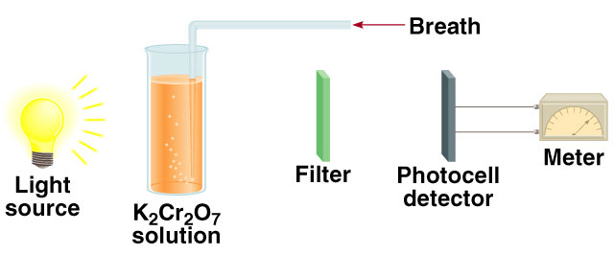
Chemistry in Action: Breath Analyzer
+6
3CH₃CH₂OH + 2K₂Cr₂O₇ + 8H₂SO₄
+3
3CH₃COOH + 2Cr₂(SO₄)₃ + 2K₂SO₄ + 11H₂O
4.4

Slide 35
Oxidation number
The charge the atom would have in a molecule (or an
ionic compound) if electrons were completely transferred.
Free elements (uncombined state) have an oxidation number of zero.
Na, Be, K, Pb, H₂, O₂, P₄ = 0
In monatomic ions, the oxidation number is equal to the charge on the ion.
Li⁺, Li = +1; Fe³⁺, Fe = +3; O²⁻, O = -2
The oxidation number of oxygen is usually –2. In H₂O₂ and O₂²⁻ it is –1.
4.4

Slide 36
The oxidation number of hydrogen is +1 except when it is bonded to metals in binary compounds. In these cases, its oxidation number is –1.
Group IA metals are +1, IIA metals are +2 and fluorine is always –1.
6. The sum of the oxidation numbers of all the atoms in a molecule or ion is equal to the charge on the molecule or ion.
HCO₃⁻
Oxidation numbers of all the elements in HCO₃⁻ ?
O = -2
H = +1
3x(-2) + 1 + ? = -1
C = +4
4.4

Slide 37
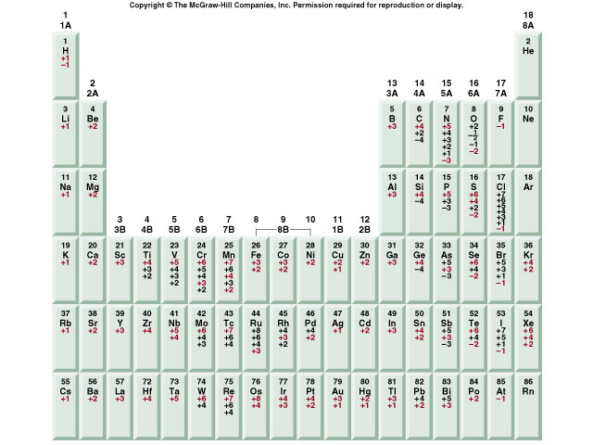
Figure 4.10 The oxidation numbers of elements in their compounds
4.4

Slide 38
IF₇
Oxidation numbers of all the elements in the following ?
F = -1
7x(-1) + ? = 0
I = +7
K₂Cr₂O₇
NaIO₃
Na = +1
O = -2
O = -2
K = +1
3x(-2) + 1 + ? = 0
7x(-2) + 2x(+1) + 2x(?) = 0
I = +5
Cr = +6
4.4

Slide 39
Acids
Have a sour taste. Vinegar owes its taste to acetic acid. Citrus
fruits contain citric acid.
Cause color changes in plant dyes.
React with certain metals to produce hydrogen gas.
2HCl (aq) + Mg (s) MgCl₂ (aq) + H₂ (g)
React with carbonates and bicarbonates to produce carbon
dioxide gas
2HCl (aq) + CaCO₃ (s) CaCl₂ (aq) + CO₂ (g) + H₂O (l)
Aqueous acid solutions conduct electricity.
4.3

Slide 40
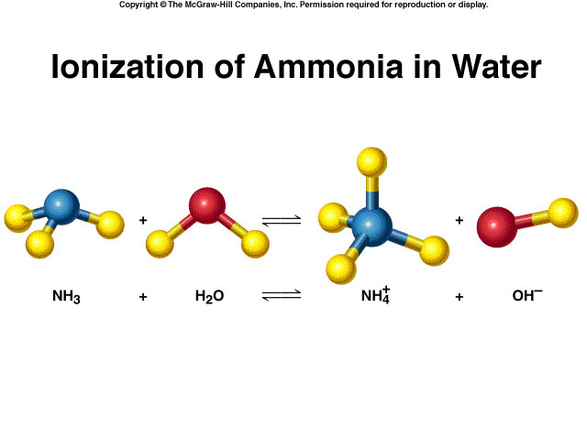
Bases
Have a bitter taste.
Feel slippery. Many soaps contain bases.
Cause color changes in plant dyes.
Aqueous base solutions conduct electricity.
4.3

Slide 41
Neutralization Reaction
acid + base salt + water
HCl (aq) + NaOH (aq) NaCl (aq) + H₂O
H⁺ + Cl⁻ + Na⁺ + OH⁻ Na⁺ + Cl⁻ + H₂O
H⁺ + OH⁻ H₂O
4.3

Slide 42
Hints
Dilute vs. Concentrated
  Heat from a concentrated strong acid may cause gas production – see II.B.4 (Ex: Nitric, sulfuric)
Gas producing decompositions
  Carbonic acid (CO₂), Ammonium hydroxide (NH₃), and Sulfurous acid (SO₂) – see I.C.11
Excess
  More about this in equilibrium – complex ions
Use Ammonium hydroxide for a solution of ammonia

Slide 43
New AP format (2013)
Example:
A student performs an experiment in which Ca(OH)₂ is reacted with 0.20 M H₂SO₄. The original volume of the Ca(OH)₂ solution is 50.0 mL. A precipitate of CaSO₄ is formed during the titration.
(a) As the first 30.0 mL of 0.10 M H₂SO₄ are added to the Ca(OH)₂ solution, two types of chemical reactions occur simultaneously. On the lines provided below, write the balanced net-ionic equations for (i) the neutralization reaction and (ii) the precipitation reaction.

